Slide 1
Training the Treasurers
Spring 2022
Presented by the RUSA Allocations Board

Slide 2
Agenda
Overview of RUSA Allocations, SABO and your Advisor
Applying for a Semesterly Budget
Overview of Funding Guidelines
Additional Important Information
Q&A

Slide 3
Overview of RUSA Allocations,
SABO and your Advisor

Slide 4
RUSA Allocations, SABO, and Advisors are separate entities with distinct roles
 | RUSA Allocations | SABO | Advisor
Think of this like… | Your employer giving you a paycheck | Your bank or checking account | A liaison
The Long Overview | We promote diversity of programming made available to all Rutgers students through the fair and efficient use of the student activity fee Fund $1M+ annually to over 400 different organizations at Rutgers | Does not provide funding, only maintains it Located in Student Activities Center | Make sure any purchases that you plan on making are approved by your advisor before making the purchase Copy your advisor on any and all emails you send pertaining to your organization, its events, and funding

Slide 5
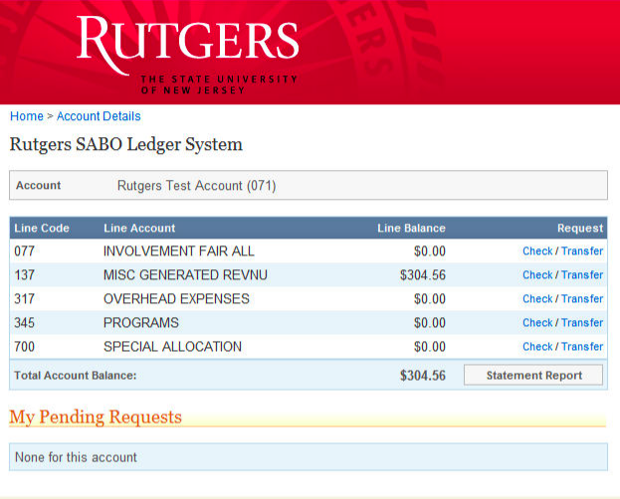
Relationship between SABO Line Accounts and Allocations:
Involvement Fair
This line is now defunct
Generated Revenue
Money generated by your org, not fundable by Allocations
Overhead Expenses
Funded by Allocations (called Organizational Maintenance)
Programs
Funded by Allocations for the 2 semesterly events
Special Allocation
Funded to Special Events which meet a pre-specified criteria

Slide 6
Applying for a Semesterly Budget

Slide 7
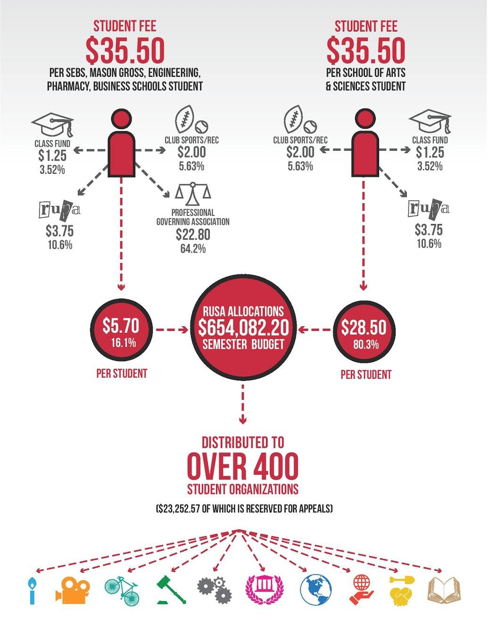
Funding is made possible thanks to the student fee.
For more information on the fee and funding breakdown, visit here

Slide 8
Each semester, you can apply for funding from RUSA Allocations. You can apply for a combination of two event types:
Stand Alone Program
Ex. Poetry slam for a poetry club that only occurs once
Series Programming
Ex. Speaker series (occurs more than once)
Stand Alone Trip ***
Ex. Trip to Museum that provides related educational component to club
Series Trip ***
Ex. Competitions, Conference, Community Service Trips
Publication
Ex. Magazine, Newsletter, etc.
You may also apply for Organizational Maintenance for semesterly expenses (e.g. pens)
*** Organizational travel has been put on hold ***
Budget applications for a given semester typically open and close the previous semester.

Slide 9
Fill out budget applications as thoroughly as possible!
Budget applications must adhere to Funding Guidelines
The budget application will be broken down into relevant categories (e.g. food, transportation, room rental and equipment)
If you are unsure of the cost of something, use Google, call a Student Center, or contact your advisor!
Fill out budget requests as truthfully and accurately as possible
Budget applications will be randomly audited to ensure accuracy
Please fill out the descriptions to explain where the numbers come from
More detailed descriptions ensure more accurate funding

Slide 10
Come to Appeals Meetings if you have any funding-related concerns
Appeals meetings are held most Monday nights from 7:00 pm - 9:00 pm. They are:
An opportunity for organizations that forgot to submit budget requests or need additional funds for programs/events
Sign-ups are first come, first serve.
Appeal sign-ups will open between the Tuesday and Friday night before the appeal date.
The meeting is informal, no presentation necessary, but bring a copy of the budget request form your organization submitted
Sample reasons to come (not exhaustive):
You did not receive funding for one or more of your requested events
Error in budget application
Did not receive as much funding as you would have hoped
Recently had a new Treasurer take over
Did not submit a budget request form and therefore have no funding for the current semester

Slide 11
Overview of Funding Guidelines

Slide 12
RUSA Allocations Funding Guidelines
RUSA Allocations and SABO have different guidelines. Generally, the RUSA Allocations Board has more requirements since the funding comes from student fees. Our guidelines are found at https://rusa.rutgers.edu/allocations/funding.
Highlights from the RUSA Allocations Funding Guidelines:
Event admission fees cannot be more than $10 if you receive funding
You cannot be funded for events on reading days, finals, and breaks
Capital equipment funding may be available for large projects
Our guidelines explain what we look for in budget applications, and what the different program types are. If you know them, they will help you ensure what your purchase is reimbursable.

Slide 13



Commonly Requested Unfundable Items
Gifts, gift cards, cash, or any “prizes” of
any sort. This can be funded through
your organization’s GR.
Parties, socials, formals, or banquets without any educational component
“Just in case” funds. Organizations
commonly request an extra $XXX in
“Other” for wiggle room, but Allocations does not fund this.
Alcohol, bail, etc

Slide 14
Additional Important Info

Slide 15
Important Spring 2022 Dates
Appeals Meetings: 2/28, 3/7, 4/11, 4/18
Board Application Closes: 3/11
Formalized dates/times to be uploaded to our website and sent through ListServ

Slide 16
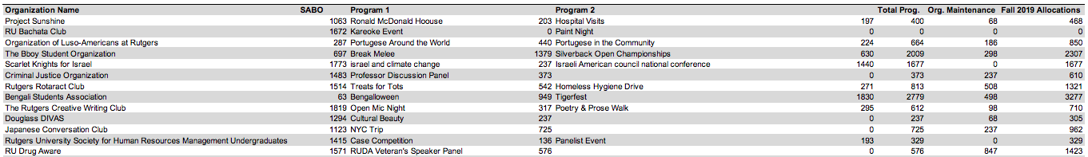
Results of budget applications are found on our website
NOTE: In SABO, program funding will appear as a lump sum under “Programs”
Allocation for the semester, not one event
Treasurers CANNOT use one program’s funding for the other
Specific program breakdown (Program 1, Program 2, & Organizational Maintenance) can be found at https://rusa.rutgers.edu/allocations/funding

Slide 17



Contact Us!
Visit our website at: rusa.rutgers.edu/funding
If you have urgent questions, comments or concerns regarding the funding process or RUSA Allocations Board, please contact us at rusa.allocations@gmail.com
Follow us on Instagram @RUSAAllocations, and Facebook for our latest updates!
**Personal Advice: Read the Office of Student Involvement’s weekly ListServ!!

Slide 18
Questions

